Slide 1
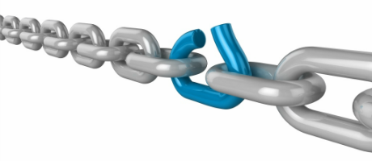
Hazard Vulnerability Analysis
Southwest Healthcare Preparedness Coalition
October 24, 2018
Updated: 9-4-18

Slide 2

  Thank you for attending today’s training!
  This training was developed by the Southwest Healthcare Preparedness Coalition in partnership with CEMA, Inc.

Slide 3
Introduction- Participants
Name
Agency/ Organization
Current Position
Years Experience
Top 5 Hazards at your organization
  Last date of your HVA

Slide 4

Introduction- Facilitator
CEMA, Inc.
James Buttleman, MA, PEM, MEP, PCP
  Lieutenant, Fire Service (14 yrs)
  Clinical Pre Hospital, Hospital, and LTC Experience (13 yrs)
  Healthcare Safety, Emergency Management, and Security (6 yrs)

Slide 5

Overview of Today

Slide 6
Today’s Agenda
10:30a-10:45a Welcome and Overview
10:45a-11:15a Module 1: Basics of an HVA
11:15a-11:45a Module 2: Tools to Assist with an HVA
11:45a-12:00p Break/ Working Lunch
12:00p-12:30p Module 3: Application of an HVA
12:30p-1:15p Module 4: Regional HVA
1:15p-1:30p Questions and Conclusion

Slide 7
Terminal Objective
  By the end of this training, the participant will be able to develop a relevant and effective Hazard Vulnerability Analysis based on current standards and best practices in the healthcare emergency preparedness field.

Slide 8
Enabling Objectives
The participant can:
Describe the fundamental components of an HVA
Describe the basic process involved in developing an HVA
Identify multiple tools available to conduct an HVA
Describe how to utilize the information from an HVA
Develop a Regional HVA

Slide 9

Module 1: Basics of an HVA
10:45-11:15

Slide 10
Basics of an HVA
This module will address the fundamental, basic concepts of an HVA and the step-by-step process used to develop a successful HVA.
How do we assess probability?
How do we estimate impacts?
How do we determine preparedness?
How do we measure relative risk?

Slide 11

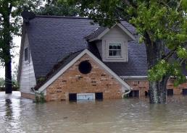


Formula
Probability + Impacts – Preparedness = Risk

Slide 12

Probability
Likelihood a hazard/ incident will occur
  Previous Emergency Operations Plan (EOP) activations
  Previous notifications/ alerts of incident
  National Weather Service
  Local Libraries
  Community Responders, Critical Infrastructure, Staff Members, Elders
Notes:
Issues to consider for probability include, but are not limited to:
1 Known risk
2 Historical data
3 Manufacturer/vendor statistics

Slide 13
Impacts
Life Safety/ Human Impact:
  Possibility of injury or death
  Patients/ Residents, Staff, Visitors
  Property Impact:
  Physical losses and damages
  Consider the uninsured costs of damages
  Business Impact:
  Interruption of Services
Notes:
Issues to consider for human impact include, but are not limited to:
1 Potential for staff death or injury
2 Potential for patient death or injury
Issues to consider for property impact include, but are not limited to:
1 Cost to replace
2 Cost to set up temporary replacement
3 Cost to repair
Issues to consider for business impact include, but are not limited to:
1 Business interruption
2 Employees unable to report to work
3 Customers unable to reach facility
4 Company in violation of contractual agreements
5 Imposition of fines and penalties or legal costs
6 Interruption of critical supplies
7 Interruption of product distribution

Slide 14
Preparedness
Preparedness:
Preplanning
    Development of an Emergency Operations Plan with Hazard Specific Annexes / Functional Annexes
    Training
    Exercising
  Internal Response
    Time, Effectiveness, and Resources
  External Response
    Community/ Mutual Aid Staff and Supplies
      These MUST be confirmed by the supporting agency/ organization
Notes:
Issues to consider for preparedness include, but are not limited to:
1 Status of current plans
2 Training status
3 Insurance
4 Availability of back-up systems
5 Community resources
Issues to consider for internal resources include, but are not limited to:
1 Types of supplies on hand
2 Volume of supplies on hand
3 Staff availability
4 Coordination with other system entities including PCPs
Issues to consider for external resources include, but are not limited to:
1 Types of agreements with community agencies
2 Coordination with local and state agencies
3 Coordination with proximal health care facilities
4 Coordination with treatment specific facilities

Slide 15
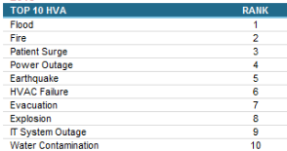
Risk
Risk= Relative Threat
Develop a list of the top 5-10 risks and use these to base your emergency management focus (More on this in Module 3)

Slide 16
Requirements- CMS EP CoPs
Center for Medicare and Medicaid Services
Risk Assessment and Emergency Planning (Include but not limited to):
  All-hazards likely in geographic area
  Care-related emergencies
  Equipment and Power failures
  Interruption in Communications, including cyber attacks
  Loss of all/portion of facility
  Loss of all/portion of supplies
  Plan is to be reviewed and updated at least annually
Rule effective Nov 15, 2017
Notes:
Risk Assessment:
The term risk assessment describes a process facilities use to assess and document potential hazards that are likely to impact their geographical region, community, facility and patient population and identify gaps and challenges that should be considered and addressed in developing the emergency preparedness program. The term risk assessment is meant to be comprehensive, and may include a variety of methods to assess and document potential hazards and their impacts. The healthcare industry has also referred to risk assessments as a Hazard Vulnerability Assessments or Analysis (HVA) as a type of risk assessment commonly used in the healthcare industry.

Slide 17
Requirements- TJC
EM.01.01.01
  EP2- The hospital conducts a hazard vulnerability analysis (HVA) to identify potential emergencies
    The findings are documented
    The findings are based on an all hazards approach
    The findings are developed by a comprehensive preparedness team (community approach)
    The HVA is developed with consideration of the entire organization (each site) (flexibility)

Slide 18

Questions about Module 1?

Slide 19

Module 2: Tools to Assist with an HVA
11:15-11:45

Slide 20
Tools to Assist with an HVA
This module will address the Kaiser Permanente HVA tool, which is the most well know and widely used HVA tool among healthcare organizations around the country.
Along with this, we will identify other aids, such as online survey platforms, that can assist with gathering information to be populated into the HVA tool.

Slide 21
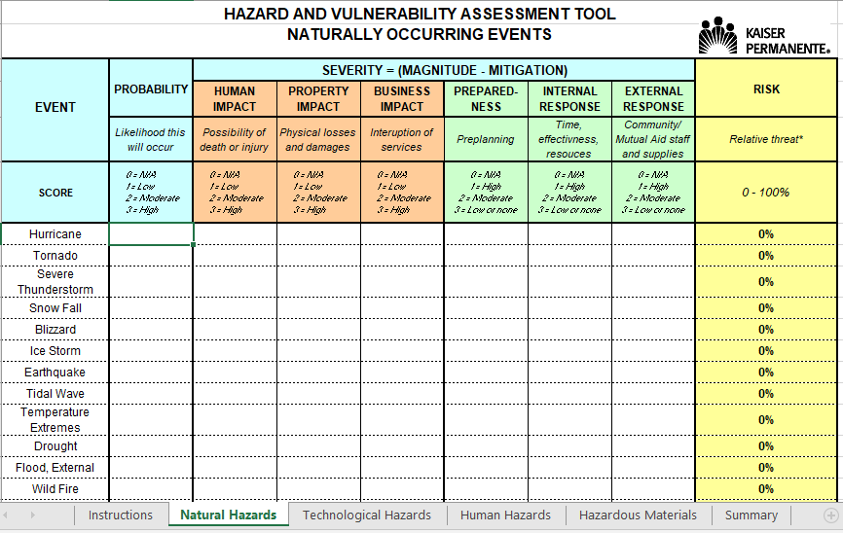
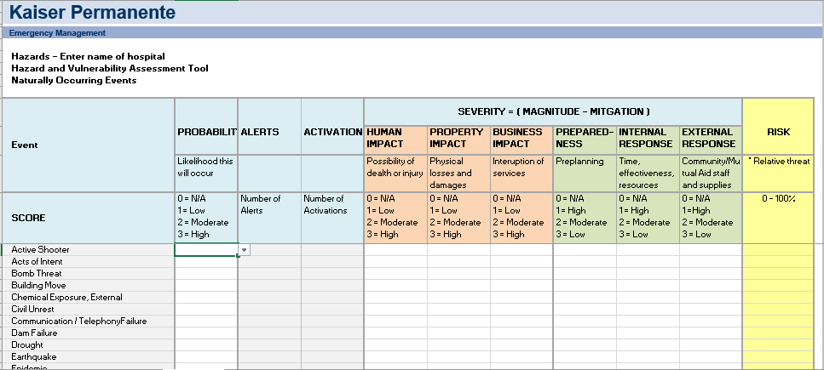
Kaiser Permanente HVA
Two templates
  2014 Template
  2017 Template

Slide 22
2014 Template
Notes:
Separate tabs for the different hazard types
Natural
Technology
Human
Hazardous Materials
Event = Hazards
Problems with this template were
Didn’t address an active assailant/ shooter/ threat situation
Summary tables were not visually appealing

Slide 23
2017 Template
Notes:
All Hazards are on a single tab (expanded hazards) Note: Remove Zombies hazard…
Allows for more site customization
Allows for continuous tracking of incidents, alerts/ notifications to provide a year end summary and statistical data to help improve emergency preparedness capabilities
Summary tab provides more visually appealing graphs/ visuals
Talk about Reference Tab

Slide 24
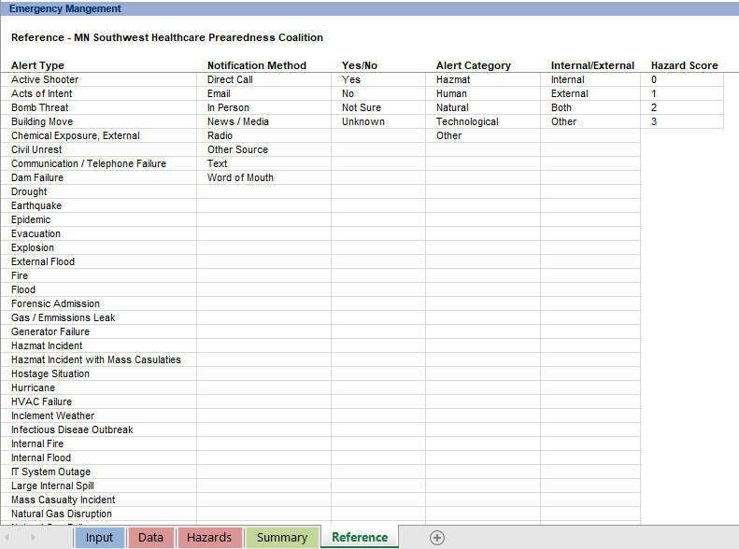
Content Customization
Notes:
Unhide tab- Reference

Slide 25

Questions about Module 2?

Slide 26

Break Time!
Reconvene at 12:00pm

Slide 27

Module 3: Application of the HVA
12:00-12:30

Slide 28
Application of an HVA
  This module describes how an HVA fits into the overall preparedness cycle.
  The HVA should be the starting place for virtually all other preparedness activities, as it informs the process of preparing for specific, relevant threats and hazards of greatest concern.

Slide 29
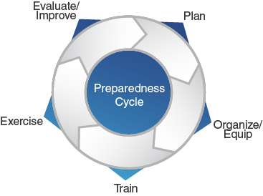
Preparedness Cycle

Slide 30
Planning
Develop a preparedness planning team
  Organization/ Agency Representatives, Community Responders, Other Healthcare Organizations, Local Emergency Management, and Key Private Sector partners
  Determine the possible hazards/ incident types
  Develop a Hazard Vulnerability Analysis
Notes:
Planning makes it possible to manage the entire life cycle of a potential crisis. Strategic and operational planning establishes priorities, identifies expected levels of performance and capability requirements, provides the standard for assessing capabilities and helps stakeholders learn their roles. The planning elements identify what an organization’s Standard Operating Procedures (SOPs) or Emergency Operations Plans (EOPs) should include for ensuring that contingencies are in place for delivering the capability during a large-scale disaster.
The National Response Framework presents the guiding principles that enable all response partners to prepare for and provide a unified national response to disasters and emergencies – from the smallest incident to the largest catastrophe. The Framework establishes a comprehensive, national, all-hazards approach to domestic incident response.

Slide 31
Planning cont.
The HVA should be the basis for the development of the Emergency Operations Plan (EOP), Hazard and Functional Annexes
Example-
If flooding is determined to be a high risk hazard then the organization should develop a hazard annex that addresses flooding response.
Additionally the HVA (Flooding Hazard) could help leadership mitigate the hazard.
  Developing mitigation strategies (cost/ benefit analysis) to determine what should be done to mitigate the risk.

Slide 32
Organize and Equip
Once the plans and mitigation strategies have been developed, based on the HVA, then this phase of the Preparedness Cycle is when teams are developed, equipment is purchased, or construction occurs.
Example- Flooding
Installing additional drains, elevating utilities, or relocating departments/ services
Notes:
Organizing and equipping provide the human and technical capital stock necessary to build capabilities and address modernization and sustainability requirements. Organizing and equipping include identifying what competencies and skill sets people should possess and ensuring an organization has the correct personnel. Additionally, it includes identifying and acquiring standard equipment an organization may need to use in times of emergency.

Slide 33
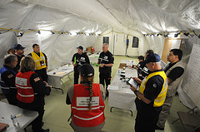
Training
Training could include educating staff on a new piece of equipment, policy/ procedure, or awareness of top hazards in the geographical area (personal preparedness)
Notes:
Training provides first responders, homeland security officials, emergency management officials, private and non-governmental partners, and other personnel with the knowledge, skills, and abilities needed to perform key tasks required during a specific emergency situation.
FEMA Training Organizations
The Center for Domestic Preparedness (CDP) develops and delivers advanced training for emergency response providers, emergency managers, and other government officials from state, local, and tribal governments. The CDP offers more than 50 training courses at its resident campus in Anniston, Alabama focusing on incident management, mass casualty response, and emergency response to a catastrophic natural disaster or terrorist act.
The Continuing Training Grants (CTG) Fact Sheet describes the key elements of the Fiscal Year Continuing Training Grants program. The CTG will help strengthen national preparedness and provide specialized training to help first responders, homeland security/emergency management officials, and citizens to prepare them for all types of disasters.
The Emergency Management Institute (EMI) serves as the national focal point for the development and delivery of emergency management training to enhance the capabilities of federal, state, local, and tribal government officials, volunteer organizations, and the public and private sectors to minimize the impact of disasters.

Slide 34
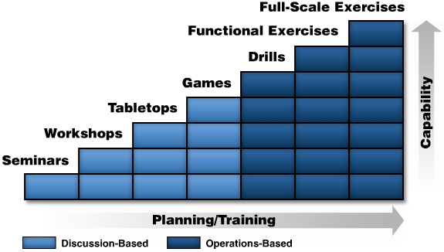
Exercising
Notes:
Exercises enable entities to identify strengths and incorporate them within best practices to sustain and enhance existing capabilities. They also provide an objective assessment of gaps and shortfalls within plans, policies and procedures to address areas for improvement prior to a real-world incident. Exercises help clarify roles and responsibilities among different entities, improve inter-agency coordination and communications and identify needed resources and opportunities for improvement.
The HVA should drive the development of the exercises including the scenario, capabilities to be tested, and participants.

Slide 35

Requirements- TJC
The Joint Commission further expects the HVA to drive the development of the emergency operations plan, mitigation activities, and other preparedness activities.
EM.01.01.01
EP3
EP4
EP5
EP6

Slide 36
Questions about Module 3?

Slide 37

Module 4: Regional HVA
12:30-1:15

Slide 38
Regional HVA
In this final module we will work through the process of building an HVA for the Coalition.
We will apply the same basic processes and resources, which have been discussed today, to develop the Coalition a simple yet functional HVA.

Slide 39
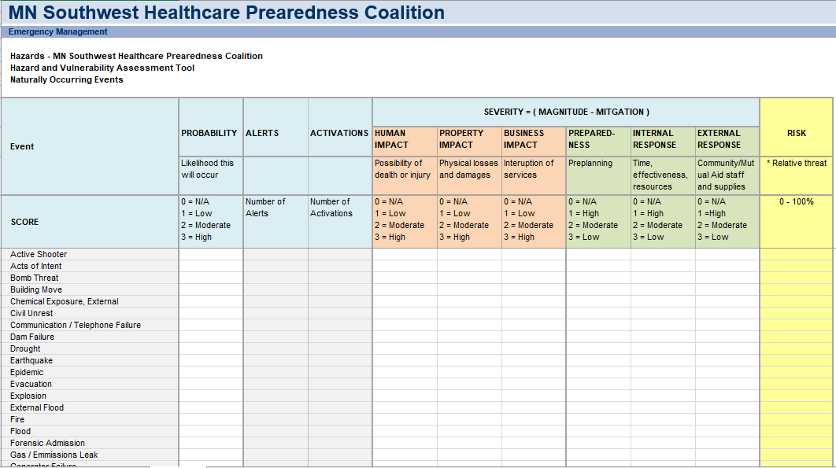
Notes:
Talk about Reference Tab

Slide 40
Questions about Module 4?

Slide 41
Course Conclusion
What is one thing that you learned today that you will take back to your organization and apply?
Any Questions?

