Slide 1
What is a Healthcare Preparedness Coalition (HHC)?
The Healthcare Preparedness Program of the Assistant Secretary for Preparedness and Response defines HCCs as:
"A formal collaboration among healthcare organizations and public and private partners that is organized to prepare for, respond to, and recover from an emergency, mass casualty or catastrophic event.“
------------------------------------------------------------------------------------------------------------------------------
HCCs are groups of local health care and responder organizations that work together on challenges and find solutions that improve emergency preparedness and the health and safety of their communities. HCCs reflect the unique needs and features of their local areas.
Membership may include: clinics, hospitals, long-term care facilities, specialty health centers, emergency management, EMS, local public health/ tribal health, & volunteer organizations.

Slide 2
HCC Core Capabilities as defined by the Assistant Secretary for Preparedness and Response
The federal government provides funding to coalitions to assist with planning under the Hospital Preparedness Program (HPP). There are some regional variabilities, however, key capabilities and goals that HCCs should strive to achieve (taken directly from the Healthcare Preparedness and Response Capabilities):
Capability 1: Foundation for Health Care and Medical Readiness- strong relationships, identify hazards and risks, and prioritize and address gaps through planning, training, exercising, and managing resources
Capability 2: Health Care and Medical Response Coordination-plan and collaborate to share and analyze information, manage and share resources, and coordinate strategies to deliver medical care to all populations during emergencies and planned events
Capability 3: Continuity of Health Care Service Delivery- provide uninterrupted, optimal medical care to all populations in the face of damaged or disabled health care infrastructure
Capability 4: Medical Surge- deliver timely and efficient care to their patients even when the demand for health care services exceeds available supply; coordinates information and available resources for its members to maintain conventional surge response

Slide 3
Essential Functions
Sharing and analyzing information: The ability to identify, process, and comprehend essential information about an incident to inform the decision-making process in a continuous and timely cycle. To provide each facility a better understanding of the scope of the disaster and the potential availability of additional assistance. Coalition members have a common venue and the ability to communicate with one another during disaster response operations.
Managing and Sharing Resources: Facilitate resource support by expediting the mutual aid process or other resource sharing arrangements among Coalition members and supporting the request and receipt of assistance from local, State and Federal authorities.
Coordinating strategies to deliver medical care: Coordination and discussion on enhanced medical surge capacity and capability, standardized response protocols, platform for real-time policy and strategy development and coordination.

Slide 4
How Minnesota Does It
The State of Minnesota has 8 Healthcare Coalition regions
Each coalition has a Regional Healthcare Preparedness Coordinator (RHPC)
Regional presence developed within states/territories to cover larger geographic areas
Preparedness capability operationalization through plans, exercises, trainings, response and after-action reports.
What a Healthcare Coalition is:
Focused on preparedness, planning, response, and recovery
A resource to connect, learn and share ideas, concepts, plans, on best practices on emergency preparedness topics
An opportunity to connect with partners and subject matter experts in emergency preparedness
A platform for members to share healthcare resources during a disaster or facilitate access to regional or state assets when available.
A collaborative forum that has voluntary membership
What a Healthcare Coalition is NOT:
An organization that has:
  Its own transportation
  A stockpile of pharmaceutical resources
  Beds for use during a surge incident
  Extra staff to support a facility
A compliance monitoring system with requirements for members to meet
A company selling emergency preparedness
A requirement for facilities to participate in (NOTE: CMS requires preparedness but not participation)

Slide 5
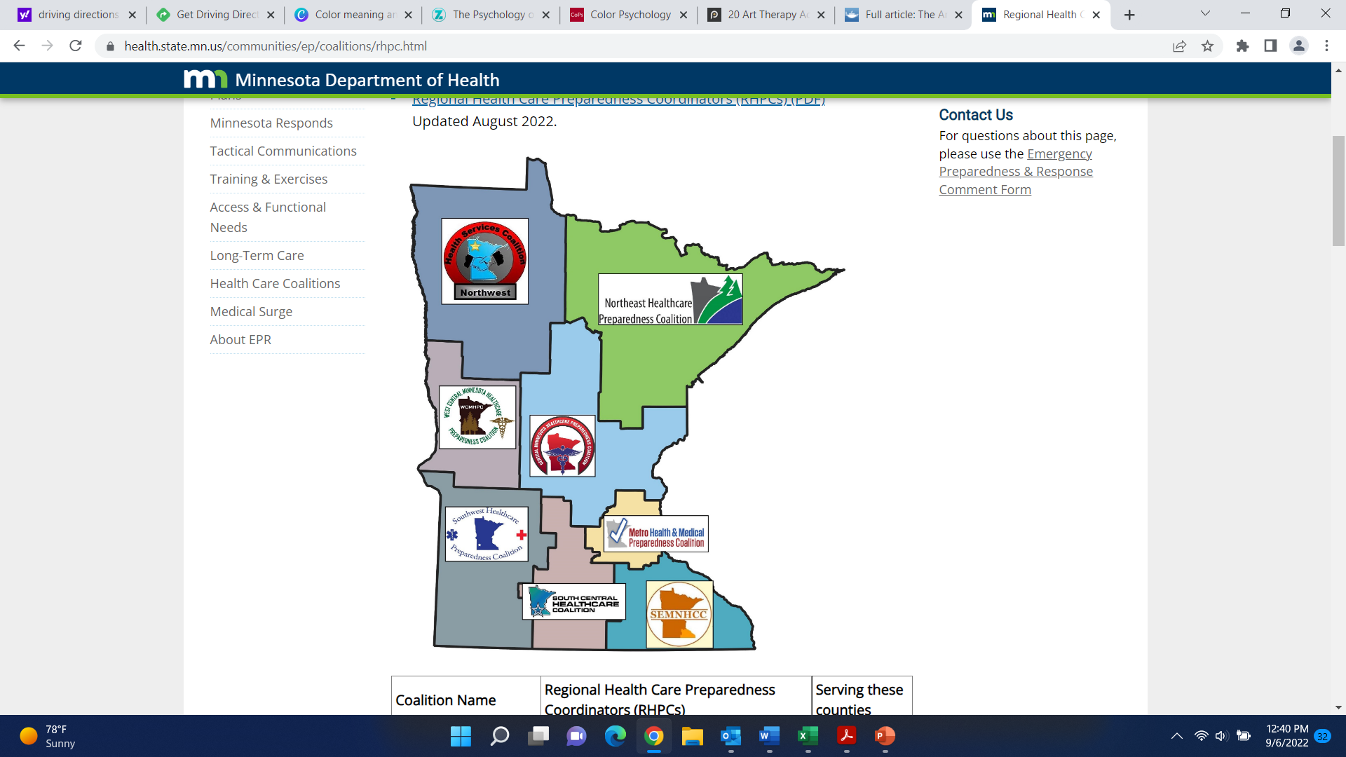

Slide 6
RESPIRATORY PROGRAM with FIT TESTING

Slide 7
OBJECTIVES
Facility’s responsibility
Develop a respiratory protection program
Medical evaluation
Fit testing

Slide 8
Introduction
Why do you need this?

Slide 9
What are respiratory hazards?
To be protected, you must wear a respirator (e.g. N95) if you:
  Work with a positive or suspected positive COVID-19, TB, or influenza resident/client
  Perform any tasks that may cause secretions to aerosolize (Link to the CDC list of aerosolizing procedures)
Exposure happens when you breathe in hazardous particles, fumes, gases, or vapors.
Exposure to respiratory hazards can cause illness and even death. Respiratory hazards can be biologic, chemical, etc.
    Examples:
    Biological: TB, COVID-19, measles, flu
    Chemical: carbon monoxide, ammonia, chlorine
    Other particles: wood dust, soot, smoke

Slide 10
Federal and State Regulatory Requirements
Employer must provide you with protection against known hazards in the workplace
  OSHA Respiratory Protection Standard 29 CFR1910.134 and 29 CFR 1926.103
  Currently, OSHA has a COVID-19 Healthcare Emergency Temporary Standard: 1910.502 – Healthcare
    Applies to settings where employees provide healthcare services or healthcare support services
    Sets requirements for the use of facemasks and respirators during the COVID-19 pandemic

Slide 11
Employer Responsibilities
The Respiratory Protection Program (RPP) is required for your facility. As the employer, you have responsibilities to keep your employees safe.
Maintenance of the fit test kit and respirators will be the cost of doing business going forward.
Employer responsibilities:
  Allow employees time to complete the tasks and trainings for the Respiratory Protection Program during paid work hours
  Identify a person as the Respiratory Protection Program Administrator (also called Respirator Program Administrator or RPA). This person will be the point person for employees and vendors. They will create and maintain the written RPP.
  Identify respiratory hazards at work
  Provide NIOSH approved respirators (e.g. N95) and timely replacements for employees whose tasks require respiratory protection
  Provide medical evaluation, training, and fit testing for employees
  Provide a plan for accommodations if the employee is not able to use a respirator (i.e. medical evaluation will not allow for N95, facial hair (and the site will have to determine how to deal with this one…..shaving required or another option.)

Slide 12
Respiratory Protection Program (RPP)
Develop a written respiratory protection program with procedures that will require respiratory use and are specific to your facility
  This document will provide your staff information on how your respiratory protection program works
  Identify workplace respiratory hazards, to include chemical and infectious agents
Implement the program and update it as required and/or as necessary.
Assign a qualified program administrator to run and evaluate the program. This person will be listed in the written plan and will be able to be used as a resource on the respiratory protection.
  A single person to oversee the program to ensure consistency and accountability

Slide 13
Program Content
To include procedures for:
  Training program; pre-use and annual
  Medical evaluation
    Licensed healthcare professional
    Confidential
  Selecting appropriate respirators for use in the workplace
  Fit testing tight fitting respirators
    Before first use, annually, any time physical conditions change (e.g. significant weight loss/gain, dental changes etc.)
  Using respirator properly in routine situations as well as in reasonably foreseeable emergencies
  Cleaning, storing, discarding
  Regularly evaluating the effectiveness of the program

Slide 14
Program Content / User Training
Include and explain:
Why the respiratory is necessary
Respirator capabilities and limitations
How to inspect, put on, remove, use and perform user seal check
Proper maintenance and storage
General understanding of the employer’s respiratory protection program

Slide 15
Program Administrator
Runs the program and evaluates its effectiveness
Qualified if he/she has appropriate training or experience in accord with the program’s level of complexity
Training or experience is appropriate if it enables them to fulfill the minimum standard requirements of recognizing, evaluating, and controlling the hazards in your workplace

Slide 16
User Training
Employers shall have an effective training program which results in the employees being able to demonstrate a working knowledge of the following:
Why the respirator is necessary and how improper fit, usage or maintenance can compromise its operation
What are the respirators working capabilities and limitations
How to inspect, put on, remove, use and perform user seal checks
How to use the respirator in emergency situations, including those involving malfunction
Proper procedures for respiratory maintenance and storage
How to recognize the medical signs and symptoms that may limit or prevent respirator use
A general understanding of the employer’s respiratory protection program

Slide 17
Respirator Selection
Must be NIOSH certified
Particulate respirators filter dust, fumes, mists and infectious particles
N (non oil resistant)
R (oil resistant)
P (oil proof)
Filter efficiency 95, 99 and 99.97 (100)%
Most common are N95 and P100

Slide 18
N95 Respirator
What does the N95 respirator do?
  It is a tight-fitting respirator. When used properly, it filters out 95% of the hazardous particles in the air.
    If it does not fit tightly against your face, it will not protect you.
    Examples of respiratory hazards: COVID-19, aerosolized flu, measles
What the N95 cannot do:
  It cannot provide additional oxygen. It only filters (purifies) air you breathe.
  It cannot protect you from vapors or gases. Vapors and gases can pass through the N95 filter.
  It cannot protect you if oil is present in the air. Oil changes how the N95 filter works. For oils, choose a different type of respirator (e.g. P95 or P100)

Slide 19
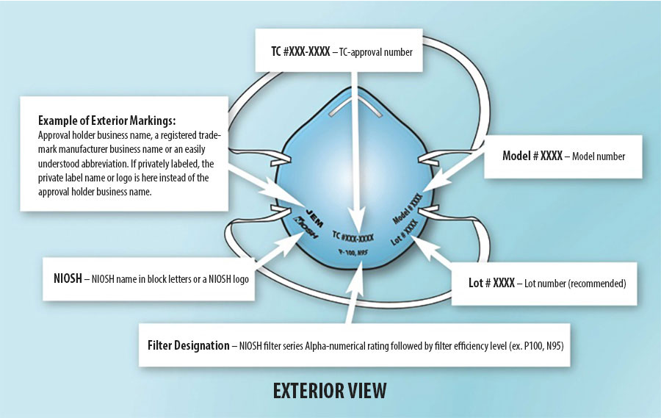
NIOSH Approved N95 Respirator
The National Institute of Occupational Safety and Health (NIOSH) evaluates respirators to be sure they will be effective
Important! The respirator used must be NIOSH approved. Be sure these markings are on your N95 before you use it! Counterfeit respirators have been found!
CDC NIOSH – Approved Particulate Filtering Facepiece Respirators, https://www.cdc.gov/niosh/npptl/topics/respirators/disp_part/default.html, accessed 6/8/2021

Slide 20
Implementing and Updating
Once the program is written and all elements are covered and approval by your site policy approval body, the program has to be updated as necessary. This means any time new processes / procedures are added or current processes / procedures are changed or modified.
Must be reviewed / updated at least annually

Slide 21
Medical Evaluation
A medical evaluation is needed because wearing the N95 can:
  Put a strain on the body because it is tight-fitting
  Make it harder to take a breath when breathing through the filter. Also, the breathing rate may increase when employees are doing their work activities.
The medical evaluation will help determine if they are able to use the N95 respirator safely.
You must provide an employee with a medical evaluation before the employee is fit tested and uses the respirator.
The information provided on the medical evaluation will be confidential. As the employer, you will not have access to the questionnaire the employee completes.
  Any physician or other licensed health care professional (PLHCP) is allowed to perform medical evaluations and will keep the medical records.
  As the employer, you will only know if the employee is approved, or not approved, to use the respirator

Slide 22
Medical Evaluation (con’t)
The questionnaire or medical examination must be given during an employee’s normal work hours or at a time and place convenient for the employee.
The employee may need a new medical evaluation when:
  The letter expires; consider setting a time limit
  If told by supervisor or program administrator
  If the employee has difficulty breathing or other issues while wearing the respirator
  Changes to the worksite conditions that may stress their body
  The employee has a major health change, such as:
    Facial scarring, dental changes, changes in weight, lung/ respiratory problems, cardiac changes, stroke, etc.

Slide 23
Medical Evaluation (con’t)
The employee must understand the questions on the medical questionnaire.
You must pay for the medical evaluation and any related expenses including travel cost incurred by your employee during the evaluation.

Slide 24
Information for the PLHCP
The type and weight of the respirator to be worn by the employee
How long and how often the employee will likely wear the respirator
The physical demands of the work and the amount of effort involved.
What other PPE or equipment will also be worn during respirator use
Temperature and humidity extremes at work
*OSHA regulations require that you provide time during normal working hours for employees to complete the questionnaire, at no cost to the employee

Slide 25
Evaluation Results- Written Medical Opinion
Medical opinion may be one of the following:
A follow up exam with a physician is required for the employee
The employee is cleared for respirator use with no restrictions
The employee is cleared with restrictions. That may mean they can’t use a negative pressure respirator on the job but could consider a positive pressure respirator instead
The employee isn’t cleared for any respirator usage

Slide 26
FIT Testing
Performed on employees who are required to wear a respirator
Every shape of N95 respirator will fit your face differently, and not all of them will fit the employee correctly
There are two methods of fit testing:
  Qualitative (uses a hood over the head);
  Quantitative (uses a machine)
Done prior to first use and annually.
Any time there is a change of respirator or change in physical appearance of the employee. Not all brands or sizes of respirators fit the same.

Slide 27
Preparing for Fit Test Day
IMPORTANT! Complete these tasks before your fit test day:
Medical evaluation
  It can be harder to breathe with the N95 on. The medical evaluation helps to be sure the employee can tolerate using the respirator.
  Have employee bring along the Written Medical Opinion from the PLHCP
Training
  As the employer, you must provide respirator training.
  Training covers how the respirator works, why the employee needs it, when the employee needs it, how to put it on and take it off, and what to do in case of emergencies
  The employee must understand these topics before the fit test appointment

Slide 28
Fit Test Day Reminders for the Employee
Remind employee to arrive early to the scheduled fit test time
  If the employee is running late or unable to attend, he/she should, if possible, let you know.
IMPORTANT! Do not eat, drink (except for unflavored water), chew gum, smoke/ vape, or apply any lip cosmetics including lip balm after the employee arrives. All of these examples may affect the ability to taste.
Dress as though employee would be going into a resident’s room
  Example: eye protection or face shield, glasses, hair covering, hair in bun, etc.
If you don’t have the Written Medical Opinion, remind employee to bring this to their scheduled time.
  This will let you know the employee is able to use a respirator without causing harm and whether or not the employee has any restrictions.
Fit testing takes different amounts of time for each person. If there are several employees being fit tested, let employees know there may be time waiting.
NOTE: If the employee has facial stubble, they will be asked to shave or reschedule their appointment.

Slide 29
Prior to Using the N95
Tie back long hair so that it is away from the face
Remove glasses, facial jewelry (if located on the lower face), and any hair coverings; straps must be on the hair
  Glasses or hair coverings may shift while working. Wearing the N95 over glasses or hair coverings can cause the seal to break and expose the employee to contaminated air.
The employee must be clean shaven.
  Facial hair or stubble can cause a break in the N95 seal on the face letting contaminated air enter the N95.
IMPORTANT! The N95 respirator must be directly on the skin, and the straps must be on your hair or scalp.

Slide 30
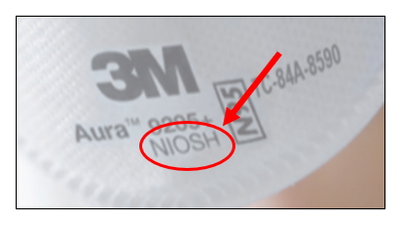
Donning the Respirator
First step is to always inspect the respirator
  Look for dirt, stains, tears, wetness, straps not attached
    If the N95 has any of these, throw it out and get another one
    Test to see if the straps are firmly attached.
  Check that the respirator is NIOSH approved
  After inspection, don the respirator. Donning may be different depending on the type of N95 used.

Slide 31
Donning
Cone-shape
  Cup the respirator in your hand with nosepiece at fingertips
  Position the respirator under the chin, while holding in place, pull the top strap over head. Continue to hold in place, while placing lower strap
Three-panel
  Fully open the top and bottom panels, bending the nosepiece around thumb at the center of foam. Make certain bottom panel is unfolded and completely open.
  Place so foam rests on nose, and bottom panel is securely under chin. Pull top strap over head and position it high on the back of the head. Then pull bottom strap over and position around neck and below ears. Adjust for comfort.
Duckbill
  Separate edges to fully open; slightly bend the nose wire to form a gentle curve
  Hold upside down to expose straps. Use fingers to separate straps.
  Hook respirator under chin and pull straps over head. Release lower strap and position, followed by top strap.
Use both hands to mold nosepiece to the shape of the nose with all models.

Slide 32
Fit test versus seal check
Fit test is a more rigorous procedure that is used to determine whether the respirator fits the face of the employee.
Fit test is done prior to respirator usage, annually and any time there is a change in physical appearance, or changing type of respirator used.
Seal check is done every time a respirator is put on to see if there are air leaks.
  Performed to ensure proper seal to the face
  Two types of user seal check:
    Positive pressure- the respirator user exhales
    Negative pressure- the respirator user inhales

Slide 33
Ensuring Seal Check
Positive pressure check
  Place hands over the respirator, covering as much surface area as possible; be sure to block the exhalation valve if the respirator has one
  Gently exhale into the respirator
  The seal is considered satisfactory if a slight positive pressure is being built up inside the respirator without any evidence of leakage of air at the seal. Examples of leakage: feeling air movement on face, fogging of glasses, a lack of pressure
  If there is leakage, readjust seal and check again
Negative pressure check
  Place hands over the respirator, covering as much surface area as possible
  The respirator should collapse / press on the wearer’s face and should not feel air passing between the face and respirator
  If it does not press against face, readjust seal and check again

Slide 34
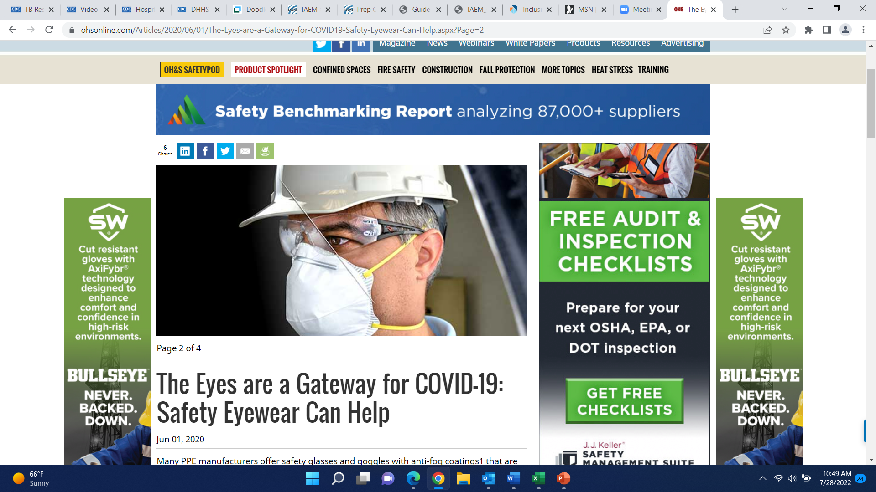
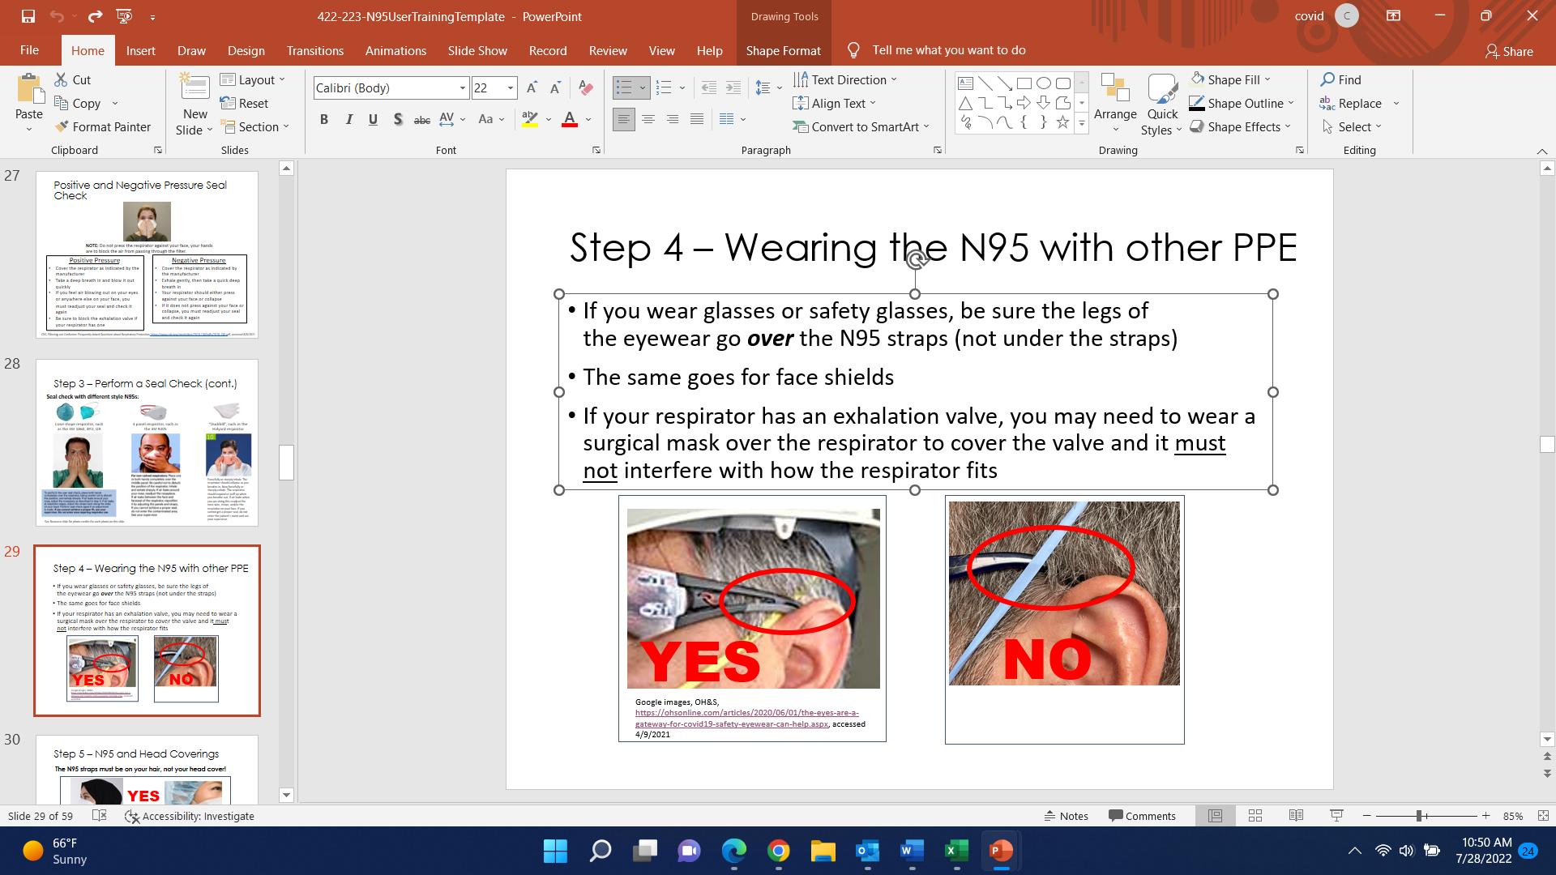
Wearing the N95 with other PPE
If the employee wears glasses or safety glasses, be sure the bows of the glasses go over the N95 straps (not under the straps)
The same goes for face shields
YES-

Slide 35
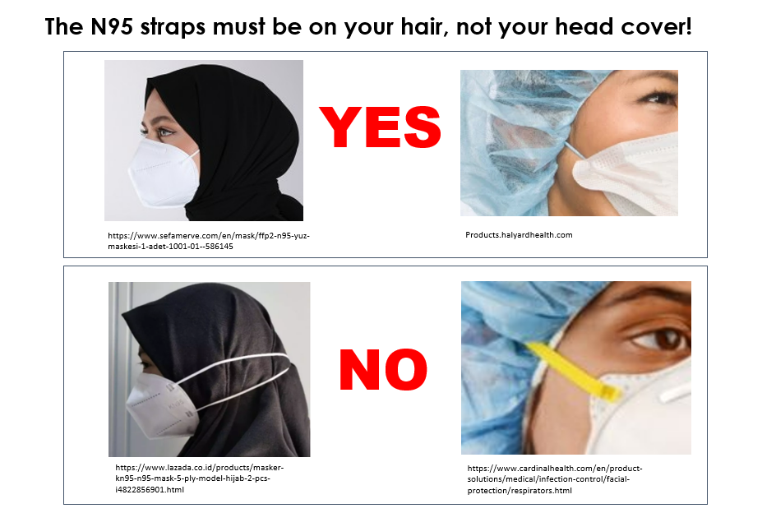
N95 and Head Coverings

Slide 36
Maintenance and Care
You must provide respirator employees with equipment that is clean and sanitary and in good working order.
Employees may not share N95s.
If you require employees to reuse, the employee will be trained on the proper storage and handling.

Slide 37
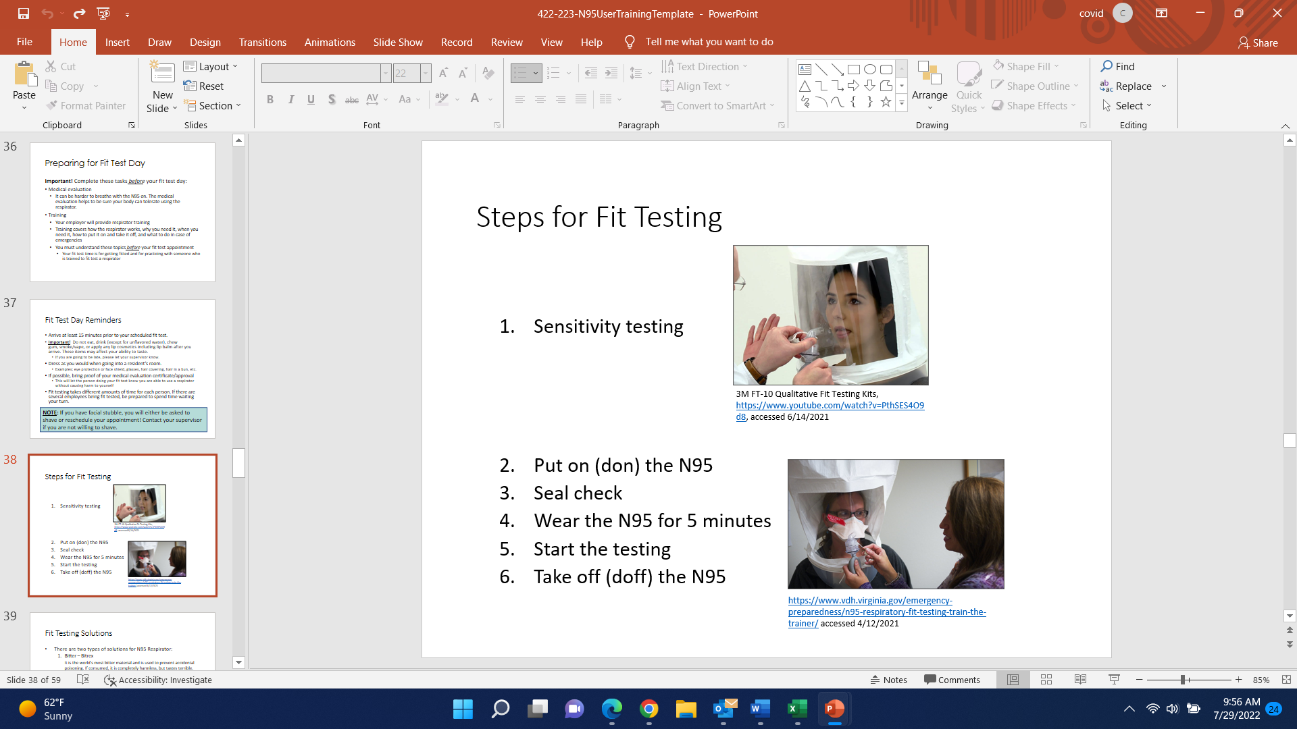
Steps for Fit Testing
Sensitivity testing
Put on (don) the N95
Seal check
Wear the N95 for 5 minutes
Start the testing
Take off (doff) the N95

Slide 38
Fit Testing Solutions & Sensitivity
There are two types of solutions:
  Bitter- Bitrex: it is the world’s most bitter material and is used to prevent accidental poisoning. If consumed, it is completely harmless, but tastes terrible.
  Sweet- Saccharine: it is an artificial sweetener.
Sensitivity test
  The purpose of the sensitivity solution is to see if the employee can taste the solution.
    During the sensitivity test, the employee will have the hood on without the respirator.
    Their mouth will need to be open and tongue slightly sticking out; breathe through the mouth throughout the entire test
    Once the employee recognizes the taste, document the number on the form.
If the employee can taste the solution while wearing the respirator during the fit test, the respirator has failed.

Slide 39
Fit Testing
The purpose of the test is to see if the N95 seal on the face can be maintained while performing movements that would normally be made during work. Each exercise will be completed while standing and repeated for 1 minute.
The fit test solution is used to help detect leaks in the N95 respirator during the fit test.
With the N95 on, the fit test solution will be added to a hood that is placed over their head.
The employee should continue to breathe with mouth slightly open:
  Normal breathing
  Deep breathing
  Turn head side to side
  Tip head up and down
  Talk out loud- read the Rainbow passage; speak as if you are talking with resident/ client that is hard of hearing
  Bend over and stand up- as if picking something up from the floor; hold hood on
  Normal breathing
*If they should taste the solution during the fit test, remove the hood, readjust the mask/ straps and try the test again.

Slide 40
Other supplies/ equipment for Fit Test
Mirror- to show the employee how their respirator fits on their face and to look at the strap placement
Gloves- to be used when sanitizing the hood in between employees
Clock with a moving second hand- a clock with a second hand makes it easy to adjust the timing if necessary and frees up your hands
Disinfectant wipes- Wipes should be unscented for those who are scent sensitive. Ensure the proper contact time. The longer contact time for disinfecting, the longer between fit tests. Do not use wipes with bleach as it is a respiratory hazard.
Hand sanitizer- have available for anyone to use
More than one model of N95 respirator- it is possible that not all of your staff will pass the fit test with one N95 model. If the number of staff is small enough, it is possible to only need one N95 model; but it is very likely that more than one model will need to be purchased.
Water and cups- the water will help get rid of the taste in their mouth after the sensitivity testing and if the N95 seal fails. The solutions are non-toxic and can be swallowed. The staff can swish and swallow the water or spit out.
Printed handouts- Rainbow passage, list of exercises, and fit test record

Slide 41
Once Fit Tested
If the employee has done all of the exercises and did not taste the solution, they have passed the fit test!
  The employee is now fit tested to that make and model of N95 only.
  If your facility no longer has that type of N95, you will need to get fit tested again to the respirator that is available.
Now that the employee is fit tested…..
The respirator fit test is an annual requirement.
The medical evaluation will need to be repeated as indicated by the Licensed Health Care Professional or when there is a change in health.
The training will need to be completed every 12 months.

Slide 42
When “stuff” happens…..
A resident/ client or a co-worker may accidentally bump your respirator
A confused resident/ client may pull off your respirator
Fluid can get on your respirator
If these things happen while you are in the isolation area:
Hold your breath and exit the isolation area as soon as possible!
  Be sure the resident is safe.
  Perform hand hygiene before leaving the room
Outside of the room, put on clean gloves and remove the respirator
  Inspect the respirator. If damaged, get a new one.
  Perform seal check before re-entering the room

Slide 43
Storage
Store clean respirators in a clean, sealable, plastic bag or container.
This protects the respirator from contamination, dust, sunlight, extreme temperatures, excessive moisture,
damaging chemicals, or destructive conditions.
This prevents the face piece from becoming deformed.
Follows all storage precaution issued by respirator manufacturer

Slide 44
Summary
Training does not need to follow a particular format.
However, as the employer, you must ensure that before the employee is required to use a respirator he/she understands the information and can use the respirator properly.
  Training will be provided before they use the respirator.
  Medical evaluation is completed during work hours and prior to the fit test
Respiratory Protection Plan will need to be reviewed annually and as needed

Slide 45
PROGRAM EVALUATION
You will perform evaluations of the workplace as necessary to make sure that your written respiratory program is working effectively. There is no specific standard interval; instead evaluate as necessary.
You will regularly consult with employees required to wear respirator to assess their views on the effectiveness of the respiratory protection program and to identify any problems that they may be encountering.
  This should include observation of: donning/ doffing, availability, storage, maintenance, and other practices and issues in all units/areas where respirators are commonly used.

Slide 46
RECORDKEEPING
The Respiratory Protection Plan must be maintained in a location that is accessible to all program participants and made available to OSHA, upon request.
Medical Evaluation Record is confidential; will be maintained by the PLHCP who does the clearance.
The Written Medical Opinion (clearance letter) should be kept on file with the fit test records.
  Respirator Fit Testing Records – current one kept until next year’s is done.
    Record should include: Name or employee ID, type of fit test performed, specific make, model style, and size of respirator tested, date of test, pass/ fail.
You must retain a written copy of your current respiratory protection program.

Slide 47
ACCESS TO RECORDS
Employees are allowed to inspect and make copies of their own records.
OSHA is allowed to inspect and make copies of all records.

Slide 48
SW Healthcare Preparednesd Coalition- contacts
Kristin Peterson, RHPC
Kristin@sw-ems.org
507-290-0265
John Maatz, Lead RHPC
swhpp@sw-ems.org
320-769-4470
After hours: 1-800-259-0195
Ann Jenson
director@sw-ems.org

Slide 49
References:
https://www.cdc.gov/niosh/docs/2015-117/default.html
https://www.osha.gov/coronavirus
https://www.osha.gov/respiratory-protection
Fit Testing Training | Washington State Department of Health
The Basics Of Respiratory Protection (slideshare.net)
Respirator Medical Evaluation Questionnaire (osha.gov)
Medical Evaluation | Center for Respiratory Proction | Respiratory Protection | 3M – US
https://multimedia.3m.com/mws/media/811783O/1860-and-1860s-wear-it-right-poster.pdf
https://www.cdc.gov/hai/pdfs/ppe/ppeposter148.pdf
https://www.cdc.gov/coronavirus/2019-ncov/downloads/hcp/fs-respirator-on-off.pdf
https://www.cdc.gov/niosh/npptl/topics/respirators/disp_part/default.html
https://www.osha.gov/laws-regs/regulations/standardnumber/1910/1910.134

